Slide 1
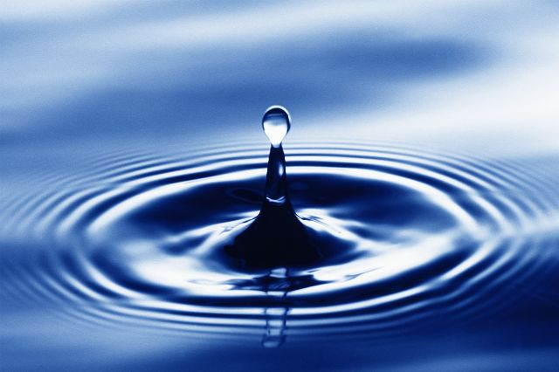
Bottled Water
The Truth About the Bottled Water Industry
Tiffany Lehwald

Slide 2
WATER: Our Most Important Commodity
By the year 2030, 2/3 of the world population will lack access to clean drinking water
Now that it is a commodity, corporate control
Americans bought 29 billion gallons in 2007
The next empire, when cost is higher than gasoline

Slide 3
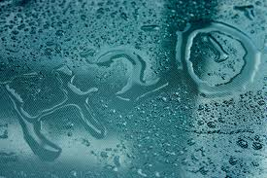
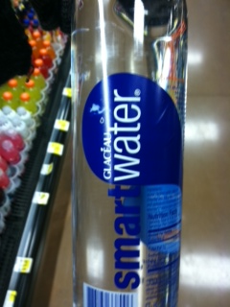
WHY BOTTLED WATER ?
The Market is very profitable
Industry has made it “cool”
Industry using celebrities
Using words like “clean”
“crisp” “fresh” “pure”

Slide 4
WATER FACTS
75% of the earths surface is water
Only 1% of the earths water is drinkable
During the year 2007, 35 states in the US were in a drought
During that same year, during the height of the drought, Pepsi pumped over 400,000 gallons a day……municipal water

Slide 5
Bottled WATER FACTS
Bottled water is not healthier than municipal tap water
40% of bottled water is filtered tap water from a municipal source
plastic bottles are made from polyethelene terephthalate (PET)
PET parazylene clear liquid from refining crude oil (benzene family, carcinogenic)
80% of PET manufactured in the US ends up in Nestle, Coke and Pepsi
Many recalls for contaminated bottle water

Slide 6
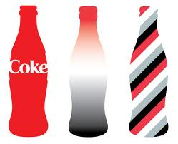
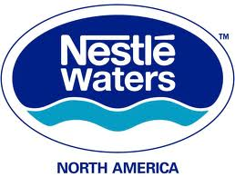
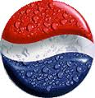
Big Corporations
Nestle
Coca-cola
Pepsi
These companies pump billions of gallons of water
a day, sell to the consumer 1900 times cost tap water

Slide 7


Largest Bottled Water Corp. in
the world.
Largest Profiteers of the water
Industry
Water Miners
3.6 BILLION dollars in sales
Arrowhead
Ice Mountain
Ozarka
Poland Springs
Deer Park
Zephyrhills

Slide 8
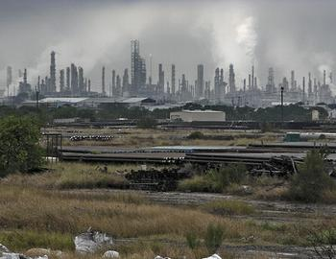
Flint Hills Corpus Christi ,Texas

Slide 9
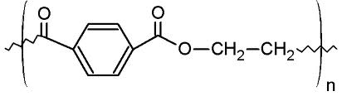
Toluene- in gasoline, paint thinner, neurotoxin agent
Styrene- known carcinogen linked with interruption in reproductive health
Diethyl Phthalate- can cause dysfunction in fetus and adverse reproductive outcomes
for both males and female
Bisphenal A (BPA) It is used to make polycarbonate plastic and epoxy resins
is an organic compound with two phenol functional groups.

Slide 10
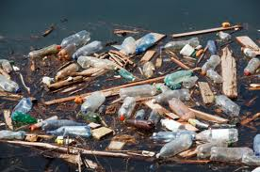

Slide 11
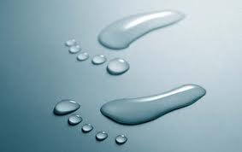
What can we do??
Stop buying bottled water
Use a refillable BPA free water bottle
Become involved and knowledgeable
about water rights in your community
Buy a home water filter
Recycle your plastic products

Slide 12
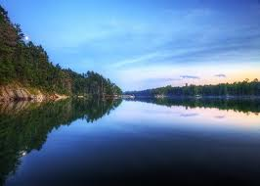
References
White, Martha C. ; TIME magazine 10/10/2011, Vol. 178 Issue 14, p40-40, 3/4p, 1 Color Photograph Document Type: Article Subject Terms: *CONSUMER goods*PERSONAL budgets*BOTTLED water
http://www.hhs.gov/safety/bpa/
http://www.fhr.com/refining/texas.aspx
http://www.epa.gov/ttn/atw/hlthef/toluene.html
http://www.tappedthemovie.com/

