Slide 1
Community Garden Project 2012
Kendal Pike
and
Tiffany Lehwald

Slide 2
The Dietetic Community Garden Project
Dr. Jamie Erskine is the leading faculty member on the Community Garden project for the Dietetic Program
Kendal Pike and Tiffany Lehwald are Dietetic students in the program that managed, cultivated and donated produce from the garden from May to October
In 2011 Dr. Erskine started the community garden project with only one plot by Nottingham Field

Slide 3
Garden Plots
In 2011, Dr. Erskine acquired 1 plot for the Dietetic Program’s students to use
In 2012, Dr. Erskine worked with Deb Deboutez, the manager of all of the Community Gardens in Greeley, to provide the Dietetic Program with two plots out of the 20 plots on the UNC campus
The plots are located by Nottingham Field

Slide 4
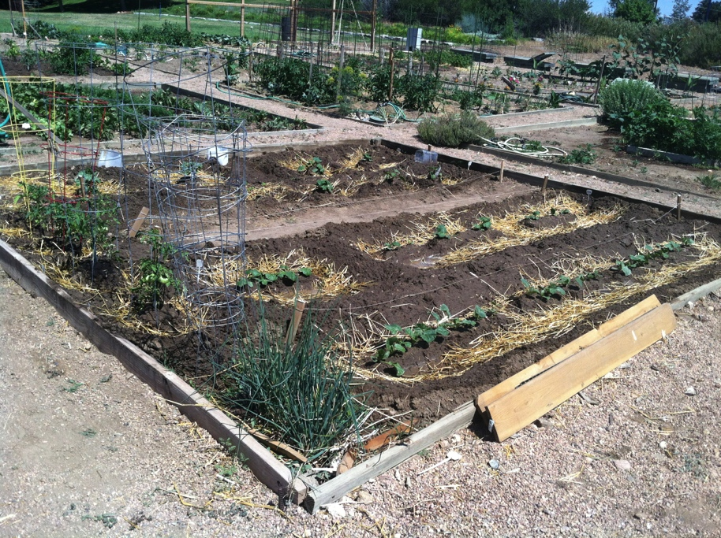
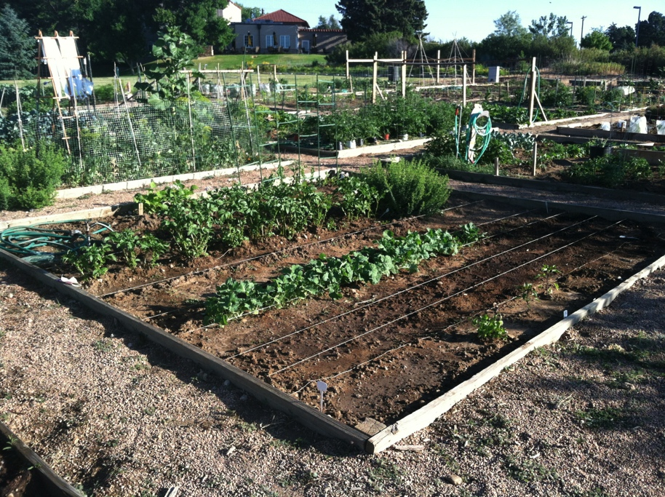
The Dietetic Garden Plots
Plot One
Plot Two

