Slide 1
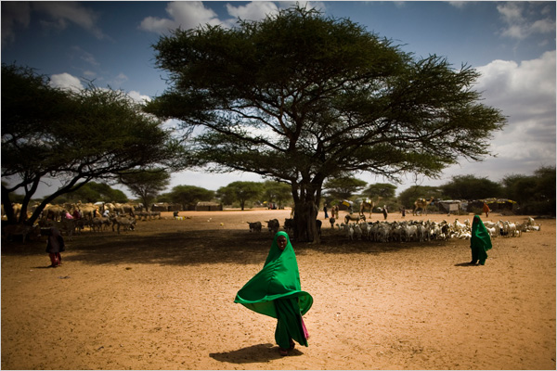
Perspectives
in medical care:
Somalian
Refugees
Greeley, Colorado
Tiffany Lehwald, Michaela Frank, Robert Burns, Jessica Darnell and Andrea Bennett ©2010
Photo: www.wunrn.com 2009

Slide 2
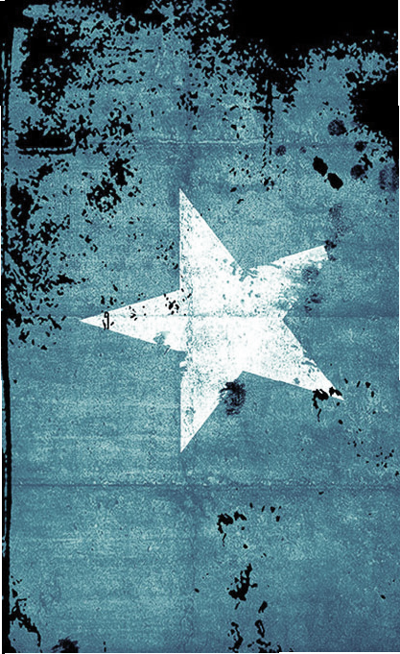
SOMALI CULTURE
Traditionally nomads and seafarers
With modernization, more are moving
into urban areas.
Widespread civil unrest has caused
many to flee to the Middle East,
Europe, the U.S., and Canada.
Minnesota has the largest Somali
population in the U.S.
Source: Cultural Orientation Research Center 2010
Photo: http://artvoice.com/issues/v9n27/refuge_to_renewal/somali1.jpg

Slide 3

CLANS & KINSHIP
Somali people are divided into clans
Clans play an important role in politics
and culture; families are Patrilineal
Marriages play an important role
in clan alliances
“Tol maa tahay”
Source: culturalorientation.net 2010
Photo: Digital Astro 2010

Slide 4
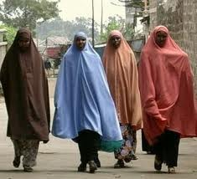
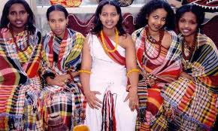
Clothing
Men wear macawis,
turbans, and jellibya
due to trade with
Arabians nations
Women wear a
guntiino, or a dirac.
Married women
wear a sash
www.diversehamilton.ca
www.deathby1000papercuts.com.

Slide 5
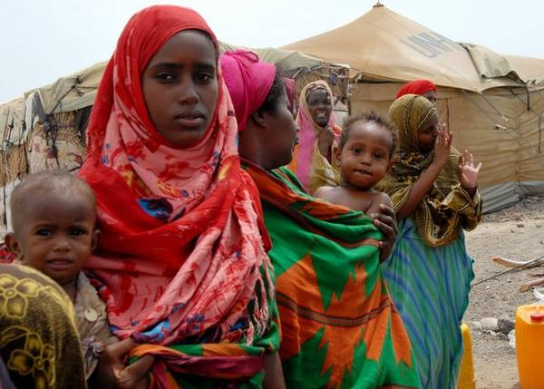
Gender Roles
Only in the past twenty years have
women been given more power in society
“A mother's purpose is to be a cook, laundry-
woman, nurturer, and wife to her husband.”
Civil war cost the lives of over 20,000 men
and displaced over 300,000 people
With declining numbers of men, 70% of
households are now run by women
So
So
Source: www.irenes.net 2010
Photo: http://www.annointed.net/blog/somalias-most-pressing-humanitarian-emergency/

Slide 6
Gender Roles
Men traditionally have the most political and social power
Men make political decisions democratically in counsels
More power and freedom given to women in recent years
Although Islamic, women are encouraged to participate in society, get an education, and can travel without presence of husband
So
Source: www.irenes.net 2010

Slide 7
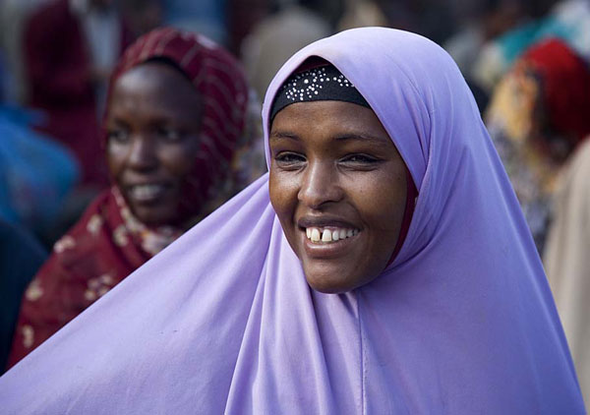
Background Facts and Figures
Lutheran Family Services of
Colorado, Refugee and Asylee
Programs, provides the lion's share
of non-governmental assistance to
Somali families living in Colorado.
Somalis resettling in the U.S. are
given in-depth background and
health screenings.
“In Greeley, the way to communicate with the Somali community is by word-of-mouth.
Fliers, posters, and other written communication, even in the Somali languages, are
not effective. News and invitations to events are spread through conversation.”
Source: University of Northern Colorado 2008
Photo by deepchi1

Slide 8
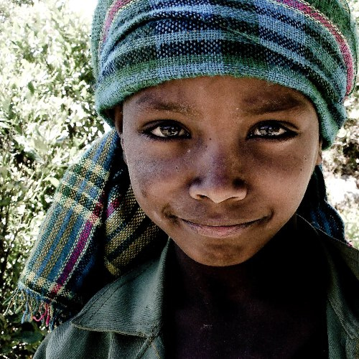
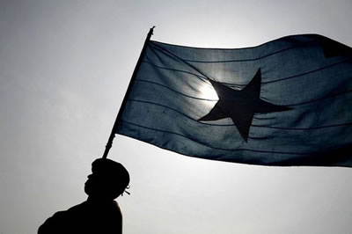
WHAT THEY LEAVE...
Few natural resources exist in Somalia
outside of a fishing industry in the North
that is plagued by poachers.
Although some oil, gas and marketable
minerals can be found, none have been
exploited today because of internal strife
and political turmoil.
The current government in Somalia is
unstable and transitional.
Somalia's desire to unify into a greater
Somalia is unpopular with its Kenyan
and Ethiopian neighbors.
Currently, a full 60% of Somalia's
population is nomadic, raising animals
such as cattle and sheep.
Only 2% of Somalia’s land is farmed.
Somalia is only slightly larger than Texas.
Source: U.S. State Department 2008
http://farm4.static.flickr.com/3012/2702504642_baa9de9b03.jpg
http://wardheernews.com/Images_09/Somali_Week/Flag.jpg

Slide 9
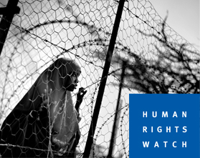
The United States is one of only 10
countries worldwide that accepts
refugees.
Almost all Somali residents in Colorado
are refugees.
None of the Somali refugees in Greeley
came directly to this area, and most
probably came from large cities.
Most of the Somali refugees who came
to Greeley first were single young men.
Most adult Somalis living in Greeley
lived in refugee camps for at least
ten years before coming to the U.S.
Somali refugees receive only 8 hours
of cultural orientation in the U.S.
Somali refugees receive Medicaid
benefits and food stamps for only 8
months in the U.S., and must pay
the government back for plane fare.
Source: University of Northern Colorado 2008
“The issue of lack of interpreters for refugees
during medical appointments is the focus of an
article in the Anchorage Press. The piece
focuses on on the case of a Sudanese single
refugee mother who was coughing up blood,
but who a medical clinic misdiagnosed
as having a “touch of pneumonia” while
refusing any suggestion that she needed
an interpreter. Doctors later correctly
diagnosed her with a heart tumor and ovarian
cancer, and operated on her twice – again with
no interpretation provided. Medical personnel
strapped her down, and then played western
music and danced in a failed attempt to calm
her as she panicked while not knowing what
was happening.”
http://forefugees.com/category/refugees-in-us/somali/ 2010
Photo by humanrightswatch.org

Slide 10
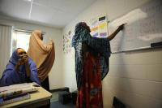
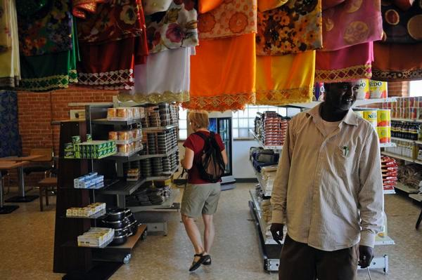
Greeley
“We have a few different
refugee populations in
the Greeley area...they
come here for Swift; it's
why they moved here”
“Some are now working
with no coverage because
no one taught them how
to access the system in
the first six months”
“Some families have
some serious medical
issues.”
“They [Burmese/Karen]
definitely face the same
barriers and have the
same needs.”
Corrine Crandall, Community
Outreach, Weld Social Services
10/2010
Photos by RJ Sandosti,
“Somali refugees take up
new roots in Greeley,”
The Denver Post, 2008
A classroom where English is taught and a grocery store
are cornerstones of the Greeley Somali community.
Although Weld County Services provides training
for employees who work with different refugee
groups, the agency's computer system is unable
to differentiate refugee populations at this time.

Slide 11
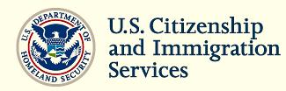
Refugees
“Under United States law a refugee is an individual who:
Is located outside of the United States
Is of special humanitarian concern to the United States
Demonstrates that they were persecuted or fear persecution
due to race, religion, nationality, political opinion, or membership
in a particular social group
Is not firmly resettled in another country
Is admissible to the United States”
Source: U.S. Citizenship and Immigration Services 2010

Slide 12
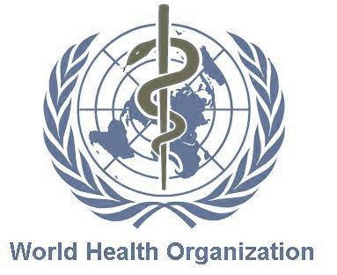
There are over 78,000 refugees admitted into the U.S. every year
-Only 12, 000 of them are from Africa
-Even fewer are from Somalia
World Health Organization Statistics:
Population of Somalia: 8.5 million
Child Deaths Under 5: 145 per 1000
Life Expectancy: 54/males 56/females
Sources: World Health Organization & The American Immigration Law Center 2010

Slide 13
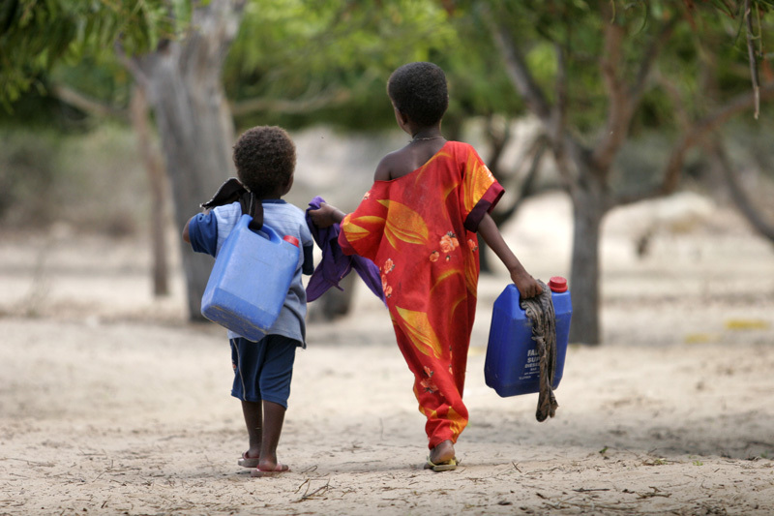
MEDICAL IMPLICATIONS
Photo: http://www.lightstalkers.org/images/show/782480

Slide 14
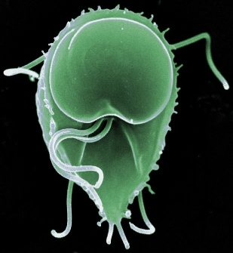
Communicable Diseases that are supposed to be treated:
Tuberculosis
Syphilis
Chancroid
Gonorrhea
Granuloma Inguinale
Lymphogranuloma Venereum
Hansen’s Disease (leprosy)
Preventable Diseases that are vaccinated for (required):
Mumps, Measles, Rubella, Polio, Tetanus, Diptheria, Pertussis
Haemophilis influenzae Type B, Rotavirus, Hepatitis A, Hepatitis B
Meningocococcal disease, Varicella, Pneumococcal pneumonia,
and Influenza
Source & Photo: Center for Disease Control 2010

Slide 15
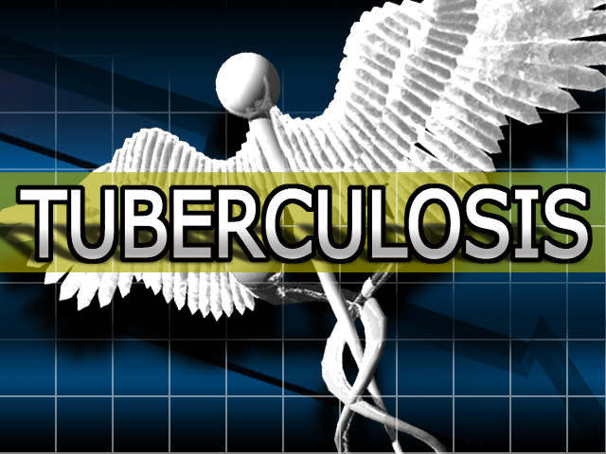
Interview with Nurse Faton Enami
at Health Department of Weld County
Use the interpreter line. It is expensive.
Offer free immunizations for children 2 mos. - 18 years old (charge no more than $14.70 for
immunizations for adults over 18 years of age)
Somali population are used to dealing with public health because they were introduced to them in refugee camps and work with them when they get to the U.S
“They find us mainly by word of mouth. The 1st 8 months of the refugee program they are exposed to us. They are aware of us because as refugees it free at first to see us.”
Immunizations, Tuberculosis and intestinal parasites (predominantly giardia lamblia).
The most important asset to the Heath Department concerning the Somali and now Burmese population is interpreters, whether volunteers or hired staff they need them.
Image by: New Jersey City University

Slide 16

How Do Different Cultures View Illness and Injury?
Traditional Healers of Somalia
General Practitioners of Somalia
• Illness may be caused by communicable disease, by God, or by spirit possession.
• Spiritual healers that use religious rituals for healing
• Wise men and women in the community that learned from elders, herbs and prayer used. Healing technique includes heated sticks from trees to cure TB, hepatitis, diarrhea and to stimulate the immune system.
• Skilled in cauterization, minor surgery, bloodletting, bone setting and the use of herbal medicine
• Mental health is a new concept to Somalis’. Common with refugees to have depression and anxiety. Many have lost their families or have been separated from them.
• 30% of refugees have been victims of torture and many were traumatized by the civil war .
Source: EthnoMed; Somali Culture Profile 2010

Slide 17

Common Misunderstandings
within Western Medicine
Blood collection (not understanding why we take so much blood)
Expectations of medications (Clinics in Somalia give anti-biotic or pain medication after visit, without meds., they feel they were not given treatment)
Concept of time (Somali patients want to leave prior to discharge, they think it takes too long)
Culture of no appointments
Male/Female roles (Husband or male of family traditionally must agree to procedure)
Source:Karusha MA, Sunrise Medical Clinic
Photo: Nursing Agency Australia 2009

Slide 18
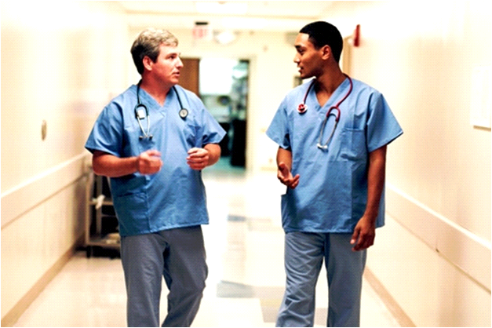
Barriers to Preventative
Screening and Services
Education-over the counter (OTC)
medications
Lack of awareness
Cultural
Language
Dissatisfied with care
Attitude of health care providers
Source: Fozia Abrar M.D. MPH 2010
Photo: Nursing Agency Australia 2009

Slide 19
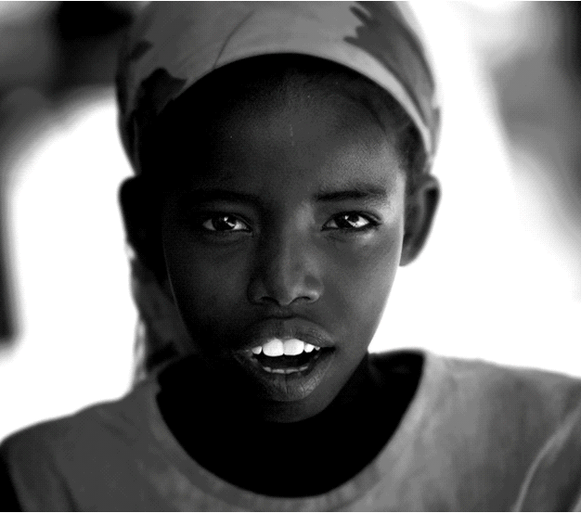
Cultural humility-process of self-awareness and reflection. It is difficult to move forward with cultural competence because of stereo-typing other cultures
Respect and compassion
Obtain a medical history considering culture
Ask about patient beliefs, practices and values
They have faith in our way of practicing medicine but they do not understand our medical system
What can we do?
Photo from PRI’s The World from the BBC, PRI and WGBH,
”Global Perspective for an American Audience.”

Slide 20
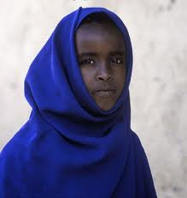
Somali Culture Gestures
A swift twist of the open hand means "nothing" or "no."
Snapping fingers may mean "long ago" or and "so on."
A thumb under the chin indicates "fullness."
It is impolite to point the sole of one's foot or shoe at another person.
It is impolite to use the index finger to call somebody; that gesture is used for calling dogs.
The Western "thumbs up" is considered obscene.
www.buzzle.com/img/articleImages/4914-29med.jp
SomaliCulture.net
2010

Slide 21
Culturally Defined
Caring is a culturally defined practice
  Health care in America can be very culturally diverse
  “ethically sound, high quality, professional practice becomes more difficult when the caregiver is not familiar with even basic cultural practices of the client. Misunderstandings can develop easily and can lead to ethical dilemmas, practice problems, and problems in communication.”
Source: Ott, Barbara 2003)

Slide 22
Aim: “to explain the essence of the experience of caring by accurately describing nurses’ ‘lived experience’ …to assist nurses and other health care professionals in caring for individuals who follow Islam”
Methodology: qualitative research of the participants’ experiences
Participants: four qualified nurses of 10 years experience, with critical care experience in Saudi Arabia
Findings: 3 themes- Family and kinship ties, Religion and cultural influences, and Nurse-patient relationships
“Caring for
patients of
Islamic denomination: critical care nurses’ experience”
Source: Halligan 2005

Slide 23
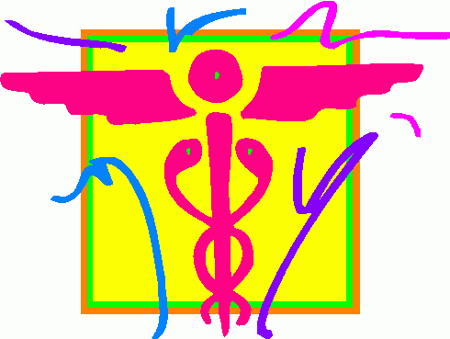
Family & Kinship Ties
Nurse-Patient Relationship
“Families were viewed as the
principle decision-makers…
they dictated the care.”
One nurse had to “…justify her
actions to the family as well
as the patient.”
“Difficulty in communicating was
considered as a major barrier in
developing a good rapport.”
“Patients and the families often
attempted to get the attention of
staff by using a number of gestures;
such as, ‘clicking of the fingers,’
which was considered aggressive.”
“Touching the patients in times of
distress was often neither welcomed
nor appreciated.”
Religious & Cultural
Influences
“The role of religion was viewed as
all-encompassing.”
“The fact that Muslims are called
to pray five times daily…is not very
conductive…to sleep and rest.”
“Whatever happens, it is Allah’s
will if they live or die.
Source: Halligan 2005
Image: pisces.eu

Slide 24
Conclusion of Research
Implications
Discussion
All actions, decisions, and judgments must be family oriented and culturally derived
  Policies need to reflect the cultural practices related to visiting, modesty, gender specific care communication and spirituality
“The process of reflection and clinical supervision could assist nurses in identifying their own cultural barriers stereotyping, and ethnocentricity, thus, ultimately improving care”
Knowledge and skill in cross cultural health care may decrease intercultural misunderstandings and their potential consequences
If the provider could recognize that “...the central importance of the family…family visiting and support (emotional, social and physical) are important ways of being together”
“knowledge of the patient’s culture may reduce some of the frustration, as one nurse noted: ‘once you learn their practices…it helps you to understand’.”
“In all nursing contexts, physical touch and patient modesty is an integral part of the nurse-patient interaction”
“What is obviously lacking…the holistic approach to caring”
Source: Halligan 2005

Slide 25
Thank you to Karusha with Sunrise Health Clinic, Corrine Crandall of
Weld County Social Services and Faton Enami, R.N. for enlightening interviews.
Special thanks to Asad Abdi of the East African Community Project for providing us with history and information of the Somali people through an interview on November 12th, 2010, and for his participation in the presentation of this material to the public.
This presentation is not for sale or paid distribution of any kind.
The information contained herein is assumed to be true and based on facts
originating from reputable sources.
Design by Andrea Bennett

Slide 26
"SOMALIS." Center for Applied Linguistics. Web. 19 Nov. 2010. http://www.cal.org/co/somali/ssoc.html.
"Signs of Change in Somalia as a Result of International and Local Actors." : Site Web De Ressources Pour La Paix. Web. 28 Nov. 2010. http://www.irenees.net/fr/fiches/experience/fiche-experience-651.html.
Horan, James, “Who to contact for More Information about Our New Somali Neighbors,” University of Northern Colorado,
Web 12 Nov., 2010, http://www.unco.edu/cebs/news/newsevents/SomaliInfo.pdf 2008
Background Note: Somalia, Beaureau of African Affairs, U.S. State Department, 8 Nov. 2010, Web 15 Nov, 2010,
http://www.state.gov/r/pa/ei/bgn/2863.htm#political
Somali Refugee Info and Contacts, University of Northern Colorado, Web 12 Nov. 2010, http://www.unco.edu/cebs/news/newsevents/SomaliInfo.pdf
Crandall, Corrine, Community Outreach, Weld County Social Services, Interview, 10/2010
“Health,” Office of Refugee Resettlement, Administration for Children & Families,U.S. Department of Health & Human Services, Web 15 Nov. 2010, http://www.acf.hhs.gov/programs/orr/benefits/health.htm
U.S. Citizenship & Immigration Services, “Refugees,” Department of Homeland Security, Web. 11 Nov., 2010,
http://www.uscis.gov/portal/site/uscis/menuitem.eb1d4c2a3e5b9ac89243c6a7543f6d1a/?vgnextoid=385d3e4d77d73210Vgn
VCM100000082ca60aRCRD&vgnextchannel=385d3e4d77d73210VgnVCM100000082ca60aRCRD
“Somalia: Country Profiles,” Global Health Observatory, World Health Organization, Web 15 Nov. 2010, http://www.who.int/gho/countries/som/country_profiles/en/
Fact Sheet: U.S. Asylum and Refugee Program, American Immigration Law Center, Web 17 Nov 2010, http://www.ailc.com/publicaffairs/factsheets/asylum.htm
Immigrant & Refugee Health, Centers for Disease Control and Prevention, Web 16 Nov. 2010, http://www.cdc.gov/immigrantrefugeehealth/
Enami, Faton, R.N., Interview, Weld County Department of Health, Nov. 2010

Slide 27
Somali Culture Profile, EthnoMed, Web 18 Nov. 2010, http://ethnomed.org/culture/somali/somali-cultural-profile
Karusha, M.A., Interview, Sunrise Community Health Clinic, 12 Nov, 2010
Fozia Abrar M.D. MPH; “Bridging the Gap New American Culture and American Health Care Experiance”
Fozia Abrar M.D. MPH, Bridging the Gap New American Culture and American Health Care Experiance, Regions Hospital,
Web 219 Nov. 2010, www.wfpha.org/2009_Turkey/Website%20postings/Monday%20S...
Halligan, Phil. Caring for patients of Islamic denomination: critical care nurses’ experience in Saudi Arabia. Journal of Clinical Nursing. July 2005. 15, 1565-1573
Ott, Barbara B. & Al-Khadhuri, Jamal. Preventing Ethical Dilemmas: Understanding Islamic Health Care Practices. Pediatric Ethics, Issues, & Commentary. May-June 2003. Vol. 29/N0.3
Rassool, G. Hussein. The crescent and Islam: healing, nursing and the spiritual dimension. Some considerations toward an understanding of the Islamic perspectives on caring. Journal of Advanced Nursing. July 2000. 32(6), 1476-1484

